Slide 1
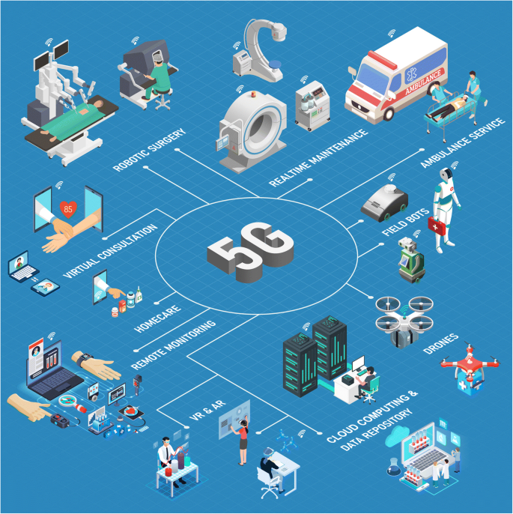
Telehealth And Teleport using Haptic sensor based On 5G connected vital measurement and sensitivity for remote care.
TEAM MEMBERS
Apoorva. M
Keerti. A
Arpana. G
L2 Faculty
Mohammad Tahir Mirji

Slide 2
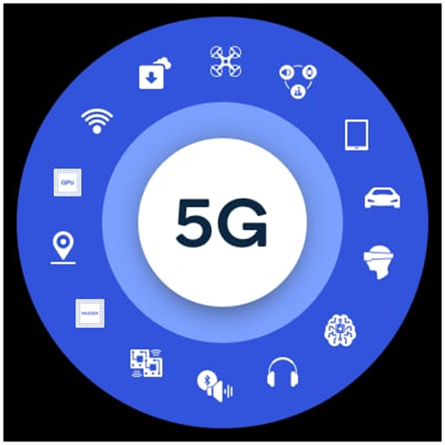
ABOUT 5G
5G is a unified, more capable air interface. It has been designed with an extended capacity to enable next-generation user experiences, empower new deployment models and deliver new services.With high speeds, superior reliability and negligible latency, 5G will expand the mobile ecosystem into new realms. 5G will impact every industry, making safer transportation, remote healthcare, precision agriculture, digitized logistics and more a reality.

Slide 3
PROBLEMS BEING FACED
We are taking into the consideration of Healthcare problem. This is one Important domain where 5g technology Can help overcome the problem of lack of expert or specialist doctors availability in case of emergency.
Doctors staying in very far places from the patients place , it Is difficult to diagnose the patient remote. Diagnostic errors due to technical limitations 34% of organizations had experienced cases of misdiagnosis due to poor photo or video quality.
This issue is partly a consequence of the previous one: video-conferencing software often automatically reduces image quality to ensure a seamless session. But problems can also arise due to congested servers or communication channels.
Unfortunately, not everything here depends on the medical company the root of the problem may lie in low-quality client-side equipment.
All the same, the company should do all it can to minimize potential complications by providing backup capacit and a spare communication channel.

Slide 4
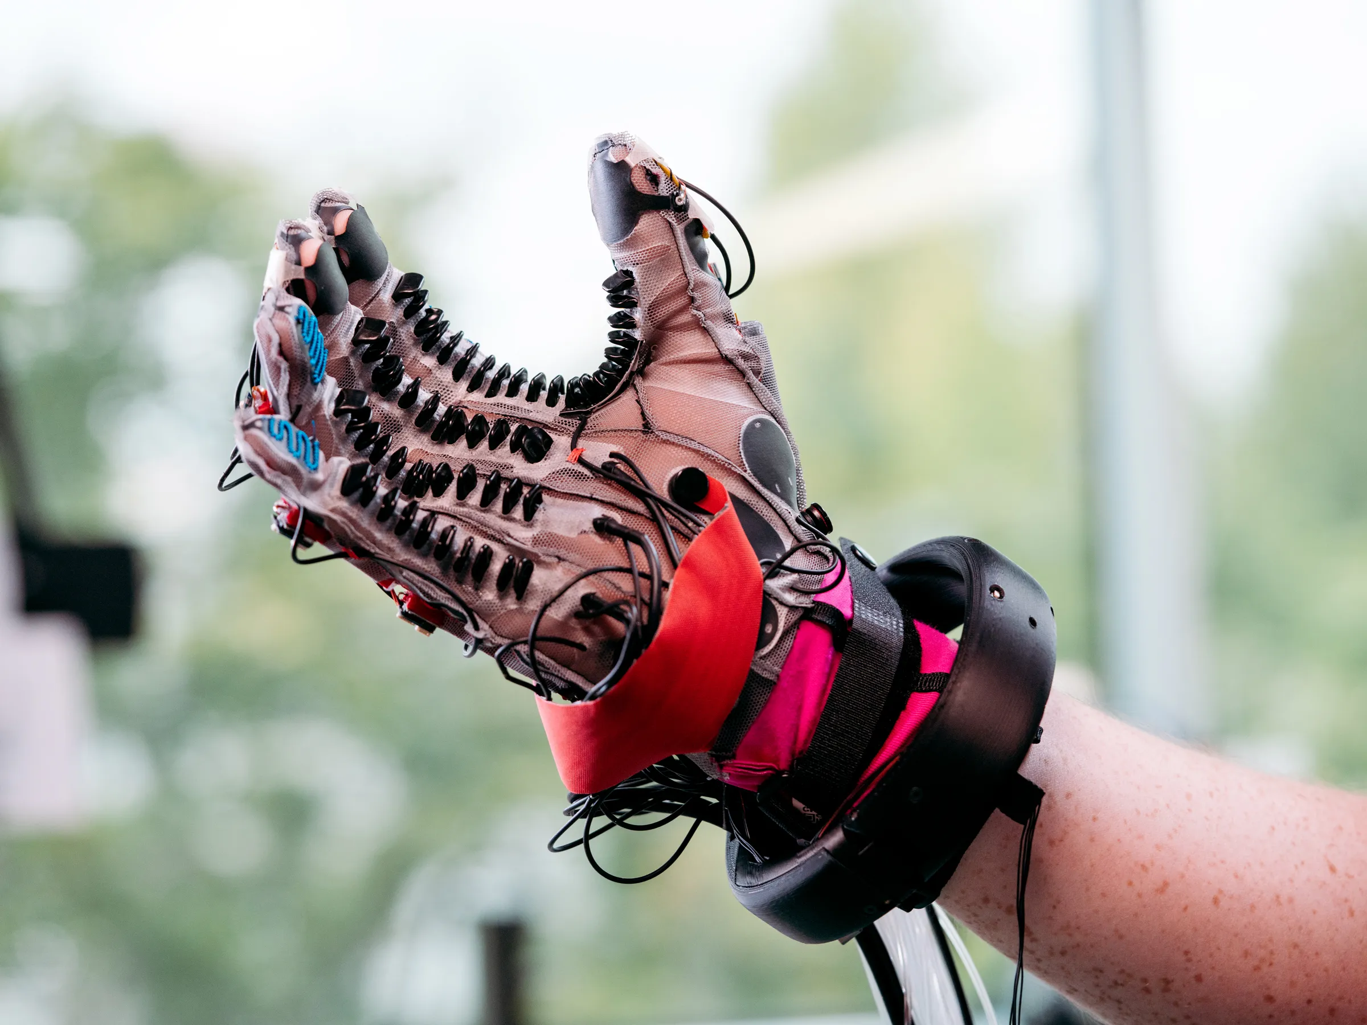
SOLUTION FOUND
Haptic gloves
The Haptic Glove is a wearable device that simulates tactile sensations of virtual objects we created a glove that provides tactile feedback of virtual objects.
When activated, it provides real feedback about the tactile sensation of holding a virtual object.

Slide 5
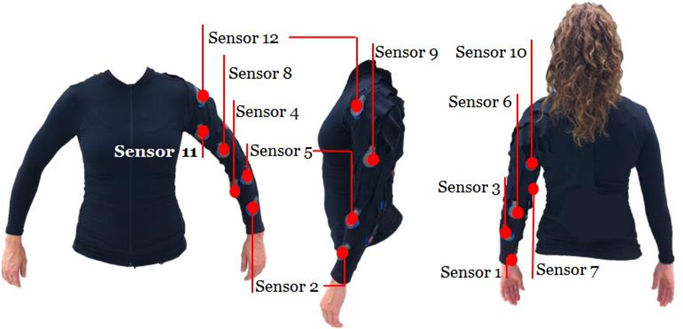
SENSOR VITAL MEASUREMENT SUIT
It contains a set of sensors and a transmitter to which the sensors are connected. The transmitter sends the data to the console, Weather Link Live, or EnviroMonitor Gateway. (Cabled stations send data from the sensor suite to the console via a cable.)

Slide 6
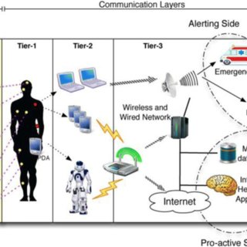
STEPS INVOLVED IN IMPLEMENTATION
In order to make surgery training more hands-on, Fundamental utilized haptic gloves that allow learners to complete surgical tasks on their Fundamental Surgery platform. Used by both trainees and qualified surgeons, this VR activity integrates the same sounds, tasks, and feelings an surgeon would experience during the actual procedure.
In this case, haptic gloves allow learners to handle equipment and carry out detailed surgical tasks without risk to themselves or a real-life patient. By completing this activity, learners can experience a true-to-life scenario that develops key skills needed to successfully perform this high-risk surgery on a real patient.

Slide 7
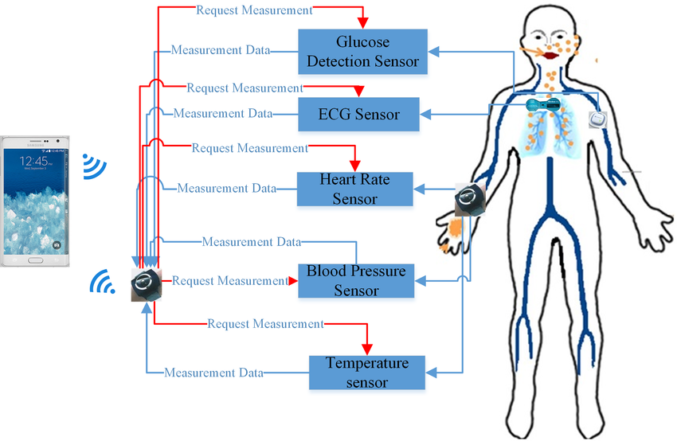
STEPS contd
The ability to monitor subtle changes in vital and arterial signals using flexible devices attached to the human skin can be valuable for the detection of various health conditions such as cardiovascular disease, Blood pressure, pulse, temperature, glucose level, oxygen level, height and weight.
Micro-electro-mechanical system (MEMS) based miniature motion sensors such as accelerometers, gyroscopes, and magnetic field sensors are widely used for measuring activity related signals.

Slide 8
MEDICAL PRACTIONER HEPTIC GLOVES SENSOR VITAL MEASUREMENT SUIT DIAGNOSIS IN REAL TIME
At a simplified level, Meta's haptics prototype is a glove lined with around 15 ridged and inflatable plastic pads known as actuators. The pads are arranged to fit along the wearer's palm, the underside of their fingers, and their fingertips. The glove also acts as a VR controller
The gloves could also simulate complex sensations such as pressure, texture, and vibration. The idea behind the gloves was to make virtual objects feel real in the hands of the wearer, and add the sense of touch to virtual reality (VR) simulations.
Allow users to experience realistic touch and interactions through advanced tactile feedback. When actuated, haptic sensors within the gloves recreate a realistic sense of touch for users.
Wearable devices provide an alternative pathway to clinical diagnostics by exploiting various physical, chemical and biological sensors to mine physiological (biophysical and/or biochemical) information in real time (preferably, continuously) and in a non-invasive or minimally invasive manner.

Slide 9
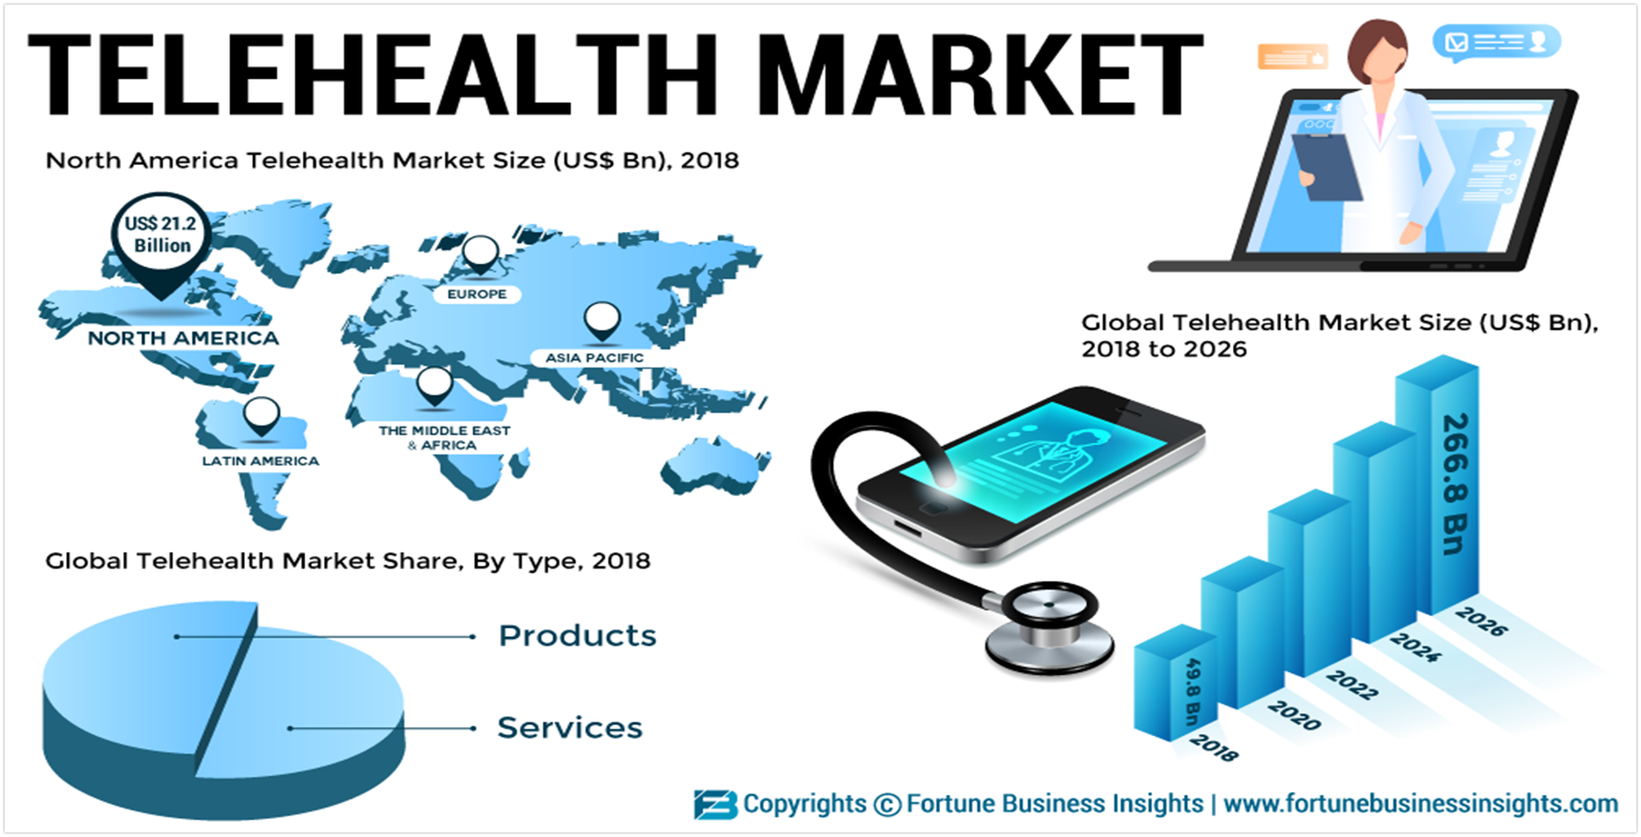
TELEHEALTH MARKET GROWTH
The global telehealth market and telemedicine market is projected to reach USD 285.7 billion by 2027, at CAGR of 26.6%. Growth in the telehealth market is mainly driven by factors such as the growing geriatric and medically underserved(espeacially rural) populations.
The benefit of telemedicine given the current shortage of physicians and care personnel, and advancements in telecommunications, and increasing technology adaption in the wake of COVID-19. however, regulatory disparities in different regions, possibility of fraud, and increasing usage of social media for care provision may restrain the market growth to certain extent over the coming years

Slide 10
THANK YOU

